Slide 1
Mining Consumer Impulsivity from Offline and Online Behavior
Fuzheng Zhang¹, Nicholas Jing Yuan¹, Kai Zheng², Defu Lian³
Xing Xie¹, Yong Rui¹
¹Microsoft Research
²University of Queensland
³University of Electronic Science and Technology of China
Notes:
Hi Everyone, I am Fuzheng Zhang from Microsoft Research, it is my great pleasure to introduce my recent work here. This work is in collaboration with Nicholas, Xing, Yong from our company, Kai from .., and Defu from …

Slide 2
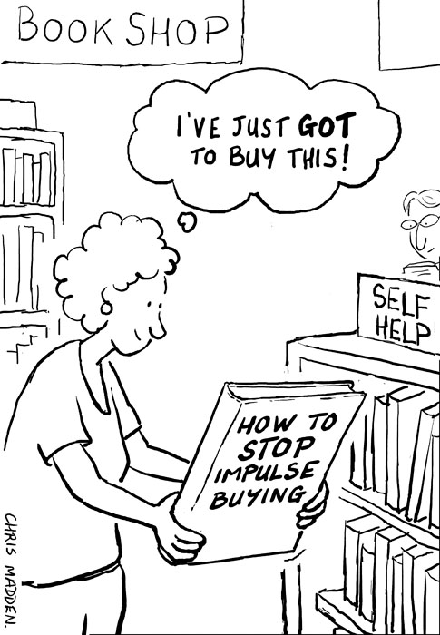
Consumer Impulsivity
In psychology, consumer impulsivity is one attribute contained in term of general impulsivity
A psychological characteristic measured in an individual making a consumption
The tendency to act on a whim, and is behavior characterized by limited forethought, reflection, and consideration of the consequences
A typical legend example in Data Mining
The Tale of Diaper and Beer
Notes:
Actually, we are all impulsive buyers. If we all take a look around our houses right now, I’m sure collectively we could find hundreds of products, clothes, equipment, gadgets and exercise equipment, we barely use or have never used. If asked now what we use them for, we probably won’t have an answer, but I’m very sure at the time of purchase we had many reason’s why they should be bought.
As humans, our unconscious mind often drives our behavior as a consumer under the influence of external stimuli. It’s very easy to feel compelled to buy somethings which no longer or ever serve’s purpose in your life.
Impulsivity (or impulsiveness) is a personality trait, describe that a person usually do things regardless of consequences
Actually, in data mining area, an very old and standard story is the tale of diaper and beer, this is a typical consume impulsive buying example. The dad only plan to buy diaper, he buy the beer just as he see it.
http://www.creditcards.com/credit-card-news/impulse-purchase-survey.php
http://betabait.com/the-impulse-shopping-fact-sheet/

Slide 3
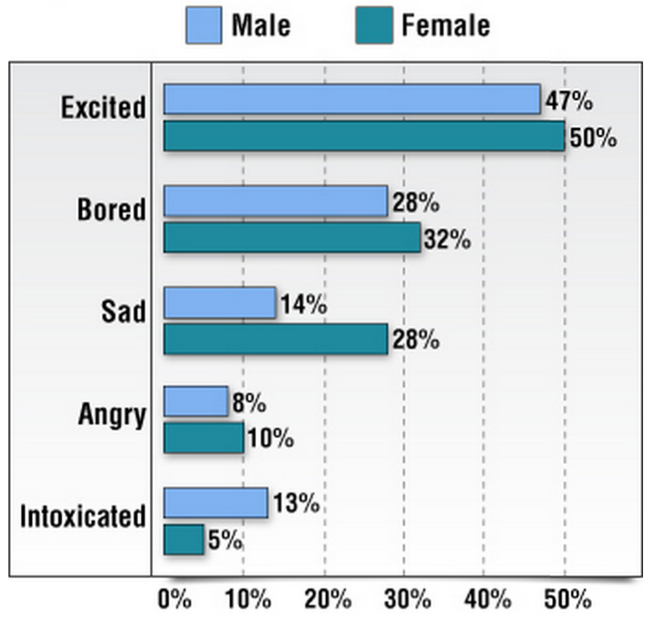
From Princeton Survey Research Associates International for CreditCards.com
Telephone survey of 1,000 adult Americans, 75% said they had made an impulse purchase
Statistics on impulsive buying
Notes:
The left picture shows the statistics of impulsive buying behavior. Which implies that discount is really a useful strategy of selling product.
Jewelry and sport equipment are more easily bought by impulsiveness. That is true, for my personal experience, I have bought a battledore
for badminton, but the fact is that after the purchase, I use it only once.
Behind every successful man, there stands a woman, she is responsible for spending your money to buy and buy.
This picture shows at what emotion status, he will buy impulsively.

Slide 4
Related Work
Consumer Impulsivity Concept
Author | Year | Contribution | Summary
Clover | 1950 | First to study impulse buying, pointed out some product categories are more sold on impulse | Only purchase itself is investigated, not focus on consumer
Stern | 1962 | Defined impulse buying behavior by classifying as planned or impulsive
Kollat et al. | 1967 | Argued that consumer’s characteristics and demographics influence the impulsive purchases | Focus on consumer trait and social-influence
Weinberg et al. | 1982 | Impulsive consumers show greater emotions such as amusement, joy and delight
Rook et al. | 1987 | Define consumer impulsion as a lifestyle trait, which can be linked to novelty seeking, recreational aspects of shopping
Wood | 1998 | Stated that socio-economic factors such as gender and household income influence impulsive buying
Applebaum | 1951 | the first to suggest that impulse purchasing may stem from the consumer's exposure to a stimulus while in the store | Focus on external stimuli
Dholakia et al. | 2000 | Visually encountering cues such as promotional incentives urges consumer to buy impulsively
Dawson et al. | 2009 | Credit card provide incentive for online impulsive buying
Notes:
We see that consumer impulsivity is everywhere and important, actually, research scholars have taken a very keen interest in impulse buying for the past sixty years in psychology, sociology and consumer behavior science. The first one focus on the purchase itself instead of the consumer’s characteristics. The second one focus on consumer trait and how it’s influenced by social influence, The third one focus that impulsive behavior is actually influenced by external stimuli

Slide 5
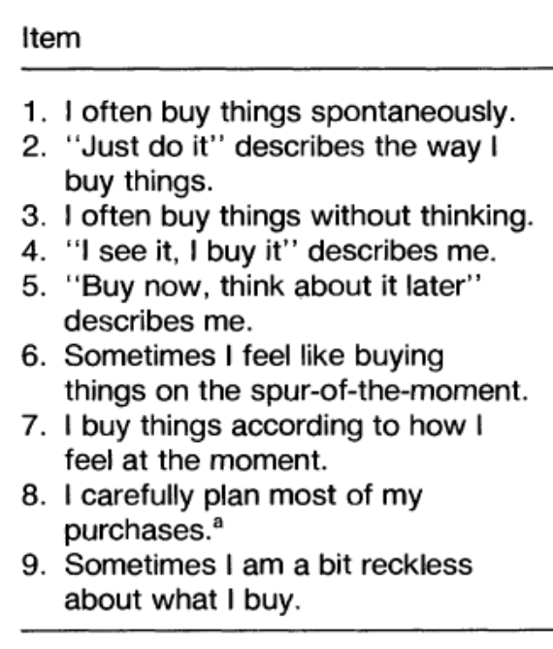
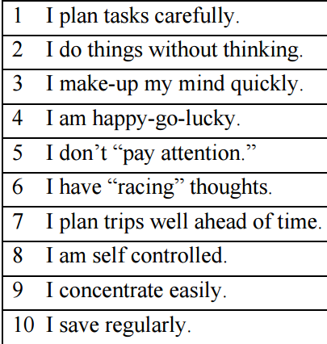
Related Work
Consumer Impulsivity Measurement
Author | Year | Contribution | Summary
Rook et al. | 1995 | a 9-item self-report questionnaire that assumes impulsive buying ranges from relative neutrality to either strong disapproval or encouragement | Direct Scales: measure consumer impulsivity directly
Puri | 1996 | a 12-item self-report questionnaire to classify subjects as prudents, moderates or hedonics
Barratt et al. | 1959 | BIS: a 20-item self-report questionnaire that is designed to assess dispositional sensitivities | Indirect Scales: measure general impulsivity trait, including non-consumption area
Whiteside et al. | 2001 | UPPS: a 45-item self-report questionnaire that is designed to measure impulsivity across dimensions of the Five Factor Model of personality
Notes:
After defining the concept, researchers also need to measure it, that is how much you are impulsivie. In the past, they mainly focus on survey or interviewed based method to measure this concept, they would like to design scales, which includes some questions related to the impulsivity concept. When you choose an answer, there will be score. Your final score of impulsivity is the average value.
Direct scales will ask questions about the consumption activities directly.

Slide 6
Our Task
For each Individual, given the stimuli perceived from social network and consumption activities, infer consumer impulsivity in a data-driven way.
Would a consumer purchase products on Amazon triggered by promotion messages or friend suggestions on Twitter or Facebook
Notes:
So, what is our task in this work. For each individual, if given the stimuli perceived from social network and his consumption activities, we want to infer his consumer impulsivity in a data-driven way. Compared to traditional survey or interviewed method, our method can be applied on a large-scale population and can avoid some shortcoming of these methods, such as be
So our work would answer the following question, would a consumer

Slide 7
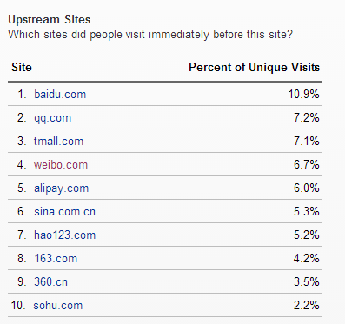
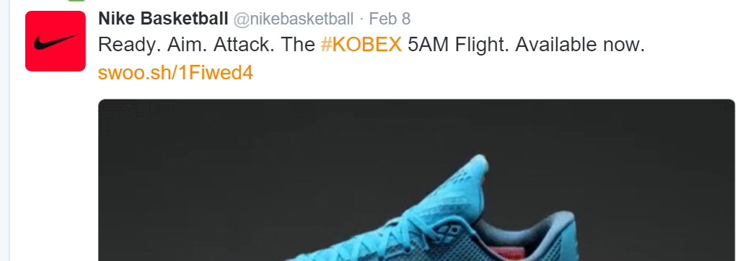
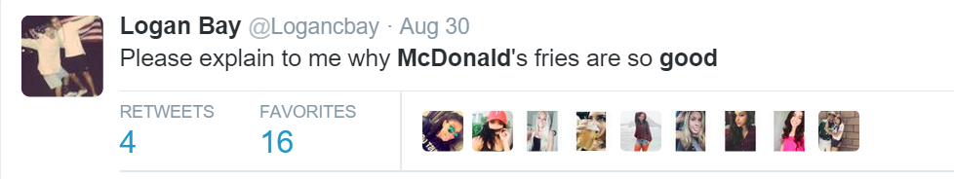
Social Network Stimuli
Alexa (http://www.alexa.com/siteinfo/taobao.com) provided that Weibo is an important entrance to Taobao
Why social network stimulate consumption
Online word-of-mouth communication through social influence activates impulse buying
Enterprises devises marketing strategies to increase sales volume by using social network sites
Notes:
Actually, there are many stimuli for impulsive buying behavior, TV and search advertisement, offline and online promotions, in this work, we focus on the stimuli on social network.
E.g, when your friend is talking about McDonald fries, you probably also want to try it. The second one is that on social network, enterprises also have made various marketing strategies to increase sales volume. So social network, as one of the main information source platform, has also become a kind of advertisement platform, that is what we are saying social consumption.
Alexa, which is famous for its website traffic analysis, Weibo, similar to twitter, Taobao similar to Ebay and Amazon, is the largest e-commerce platform in China. We can see about six point seven percent of users would visit Taobao after they see something in Weibo.

Slide 8
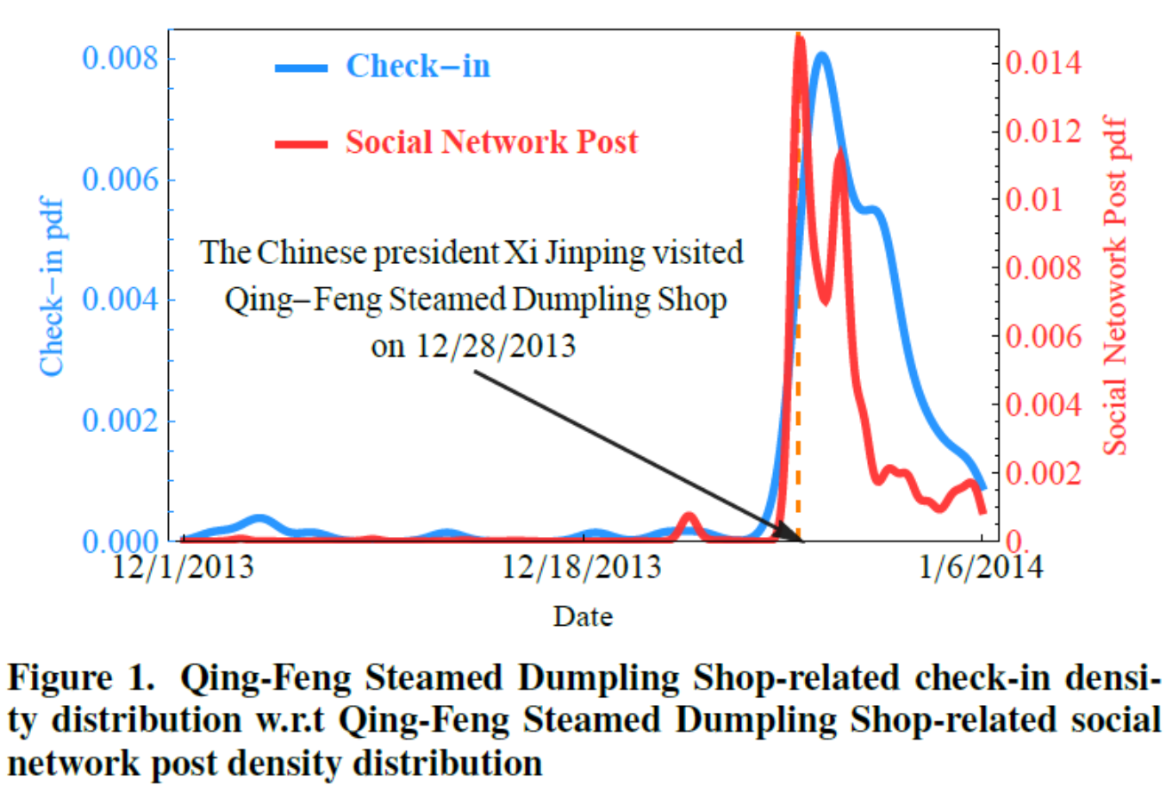
Social Network Stimuli
A typical example for offline consumption
Check-in data (consumption activity)
Social networks post (stimuli resource)
Notes:
In our dataset, we also find a typical example for offline consumption. Here, for consumption activity, we use check-in data. For stimuli on social network, we use the post data. This figure shows that Chinese president, Xi jinping will visited a restaurant called Qing-Feng Steamed Dumpling Shop on Dec 28, 2013, so there are a lot twetts on social network talking about this event. The interest thing is, in the following days, many users will also visit that shop, obviously, we can say that they are influenced by the information on social network, social network actually act as a stimuli for this offline consumption behavior.

Slide 9
Dynamic Option Matrix
Notes:
Now, before talking about our model, I will introduce some concept related to it. Consumer behavior is sequence, where each node means that he has a purchase behavior. The sequence is in a chronological order. For his each consumption behavior, we assume there are some candidates for him, what we mean option. For each consumption behavior, we also focus on the recent posts this user sees on social network, and we will compute that a candidate is talked frequently or not on the social network. So dynamic option matrix actually describe this. For all the candidate, we will order them by this frequency, where large value means frequency is large. So the column of the matrix is the candidates, the row describe for each consumer behavior, the order the candidate frequency on social network.

Slide 10
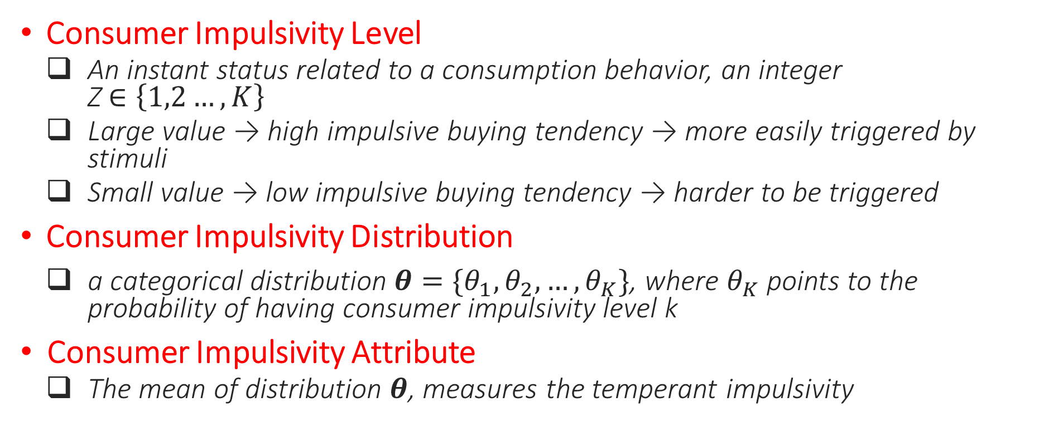
Impulsivity Concept
Consumer Impulsivity Level
An instant status related to a consumption behavior, an integer Z$∈\left\{1,2…,K\right\}$
Large value → high impulsive buying tendency → more easily triggered by stimuli
Small value → low impulsive buying tendency → harder to be triggered
Consumer Impulsivity Distribution
a categorical distribution $θ=\{θ_{1},θ_{2},…,θ_{K}\}$, where $θ_{K}$ points to the probability of having consumer impulsivity level k
Consumer Impulsivity Attribute
The mean of distribution $θ$, measures the temperant impulsivity
Notes:
Ok. Next, let’s how we formally define consumer impulsivity in a mathematical way. The first term is called consumer impulsivity level, it describes for a user’s each purchase behavior, there is an instant status.
Well, consumer impulsivity is related a specific behavior, we know consumer impulsivity is a kind of personality trait, so we use the term to describe his overall behavior.

Slide 11
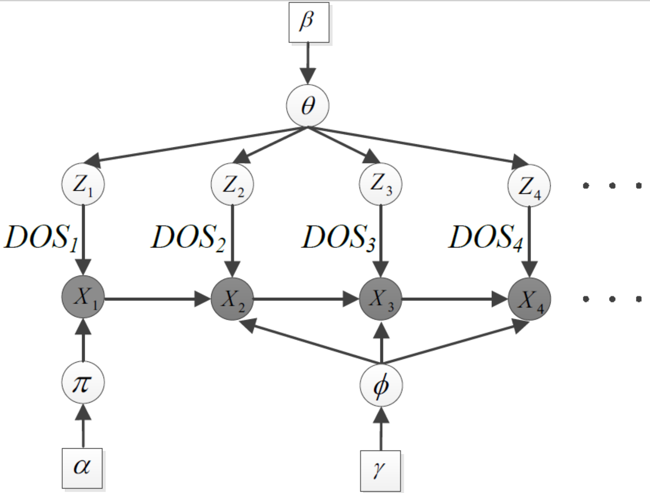
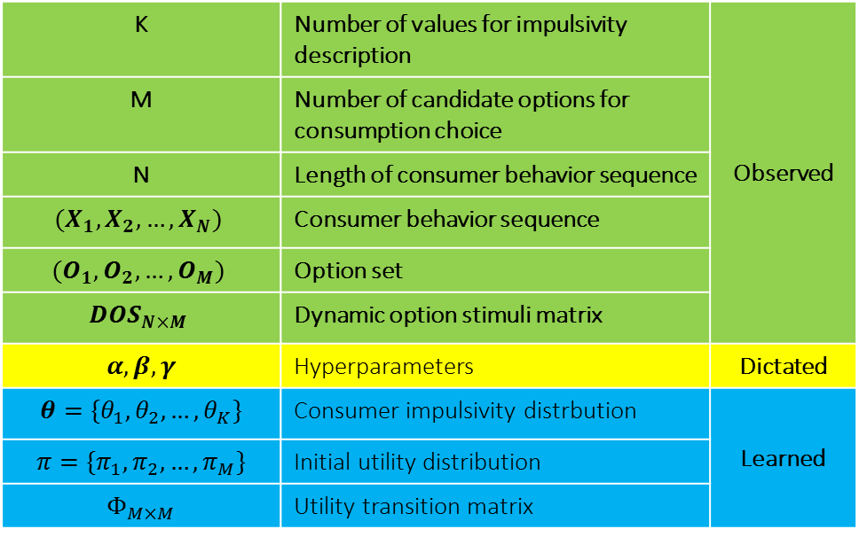
Consumer Impulsivity Model
K | Number of values for impulsivity description | Observed
M | Number of candidate options for consumption choice
N | Length of consumer behavior sequence
$$(X_{1},X_{2},…,X_{N})$$ | Consumer behavior sequence
$$(O_{1},O_{2},…, O_{M})$$ | Option set
$$DOS_{N×M}$$ | Dynamic option stimuli matrix
$$α,β,γ$$ | Hyperparameters | Dictated
$$θ=\{θ_{1},θ_{2},…,θ_{K}\}$$ | Consumer impulsivity distrbution | Learned
$$π=\{π_{1},π_{2},…,π_{M}\}$$ | Initial utility distribution
$$Φ_{M×M}$$ | Utility transition matrix

Slide 12
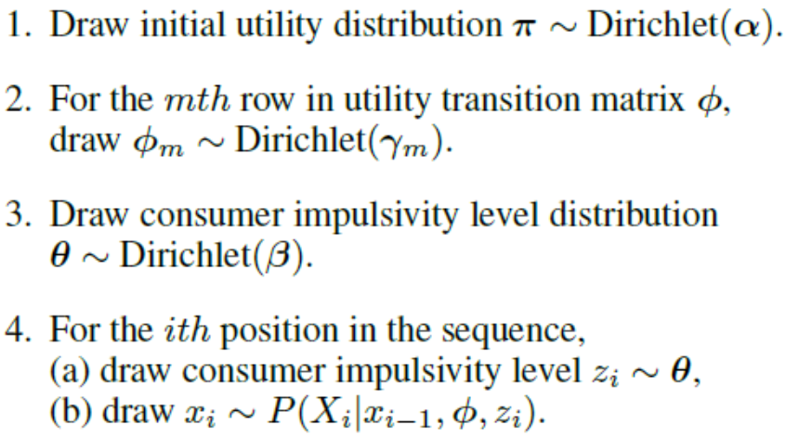
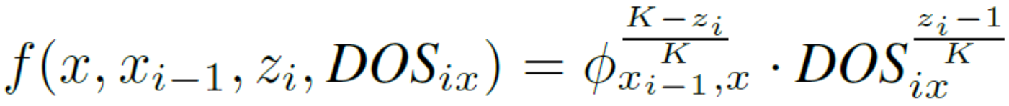
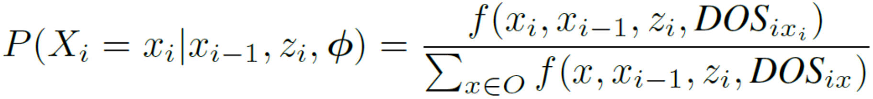
Consumer Impulsivity Model
Observation generation procedure:

Slide 13
Consumer Impulsivity Model
Inference procedure:
Gibbs Sampling

Slide 14
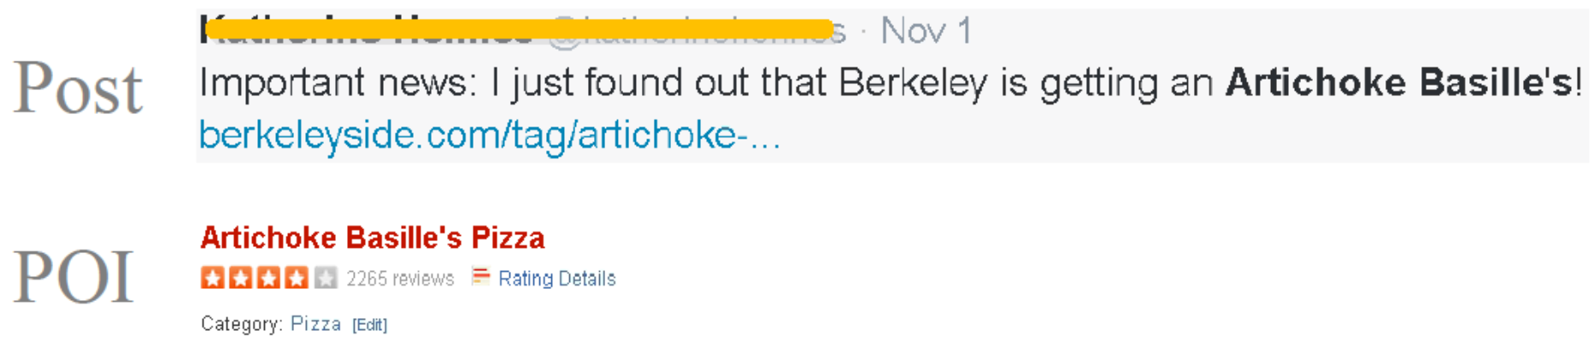
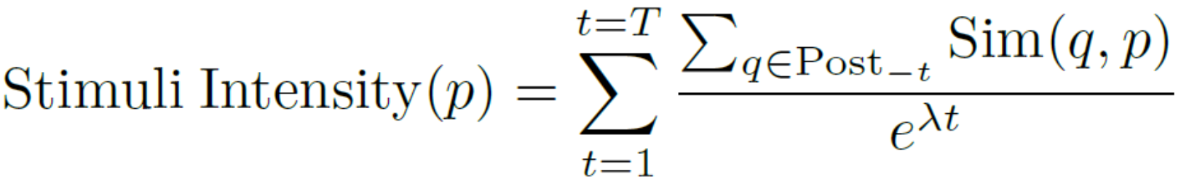
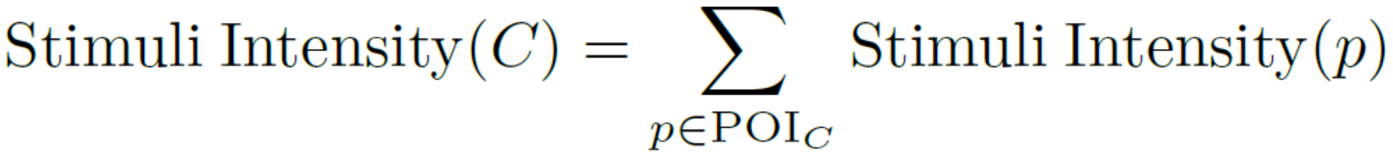
Offline Consumption Behavior
Consumption activities in check-in behavior (Sina Weibo)
Stimuli Strength Computation
Notes:
By using our consumer impulsivity model, we want to investigate a user’s impulsivity in both offline and online context. For offline consumption behavior, we focus on check-in behavior. A check-in behavior is that user explicitly tell you he is at a place at a time.
His offline consumption sequence is the POI sequence. However, there are acutally too many POIs, a user might choose a POI just by accident, so the consumver behavior can also be mined at the category level, where category can represent a user’s lifestyle in a more semantic way. The most direct way is to count the frequency title in the post.
A modified overlap similarity

Slide 15
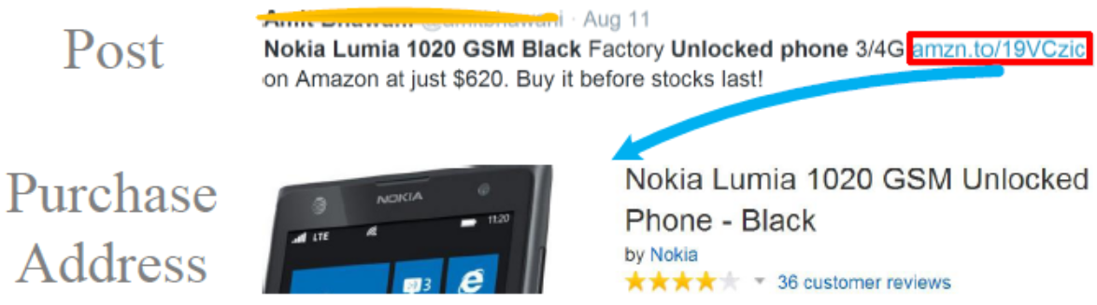
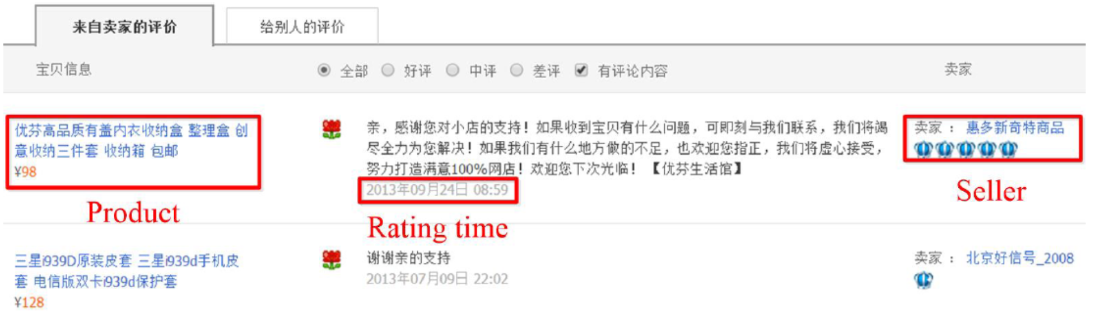
Online Consumption Behavior
Purchasing behavior on E-commerce website (Taobao)
Stimuli Strength Computation
Notes:
For online consumption, we focus on buying behavior on E-commerce website. To get a user’s buying records on this website, we crawl data from his credit page. Where each records indicates that he rate a product at a time and we use this rating information to represent his buying behavior.

Slide 16
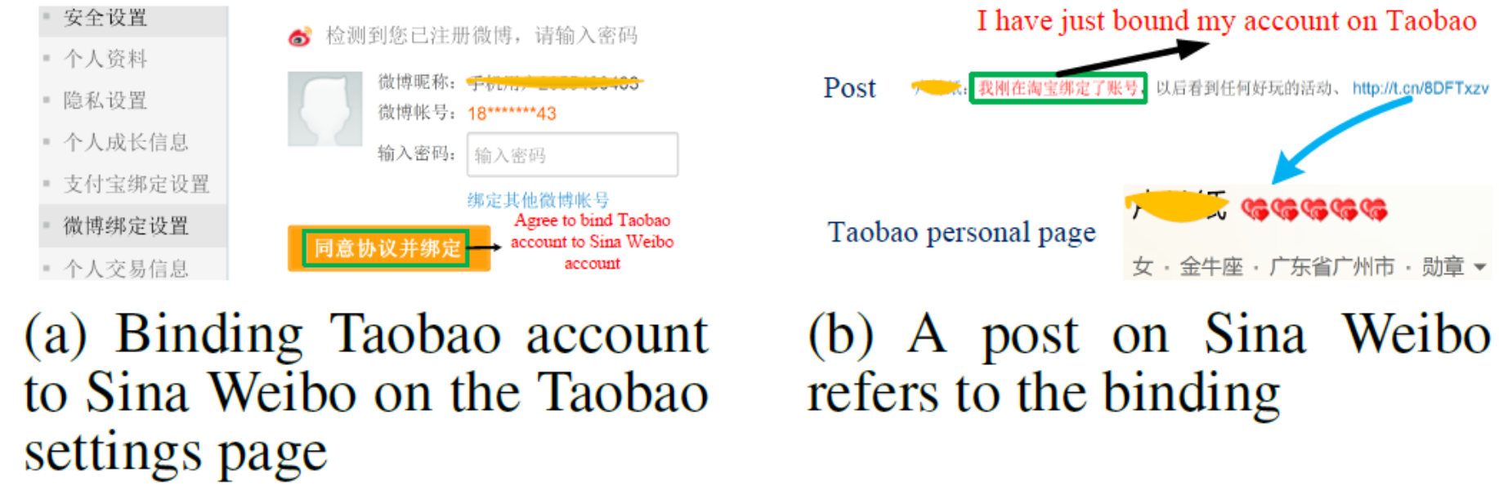
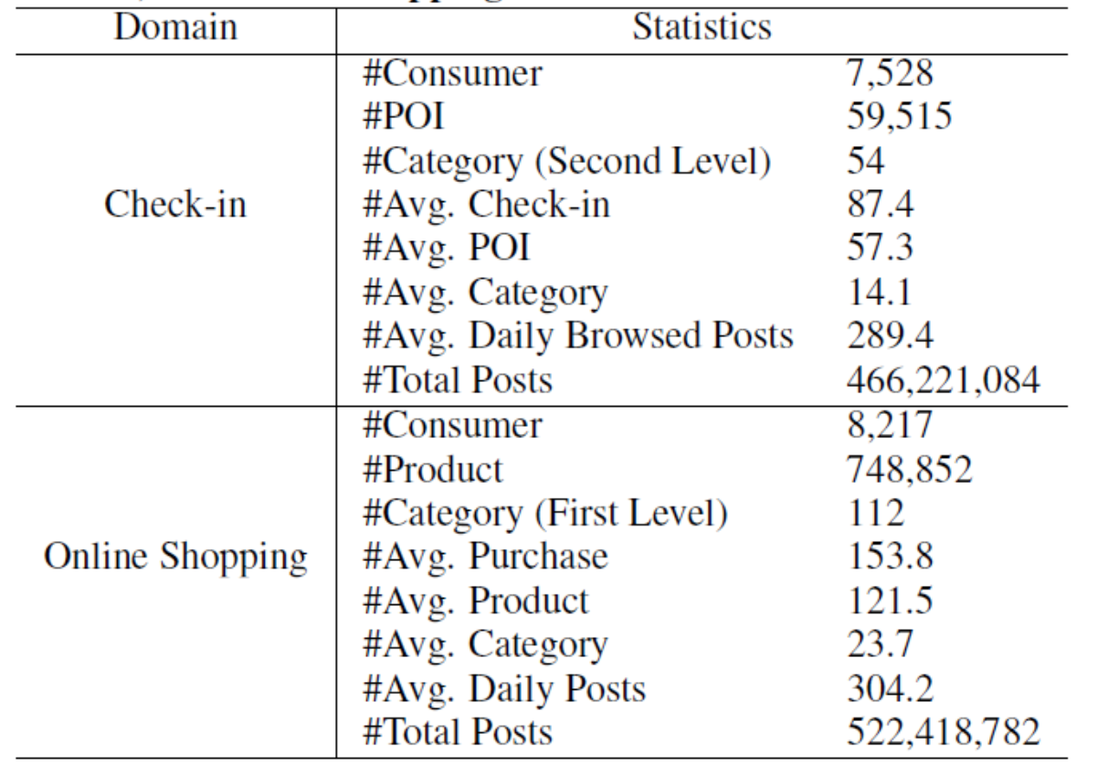
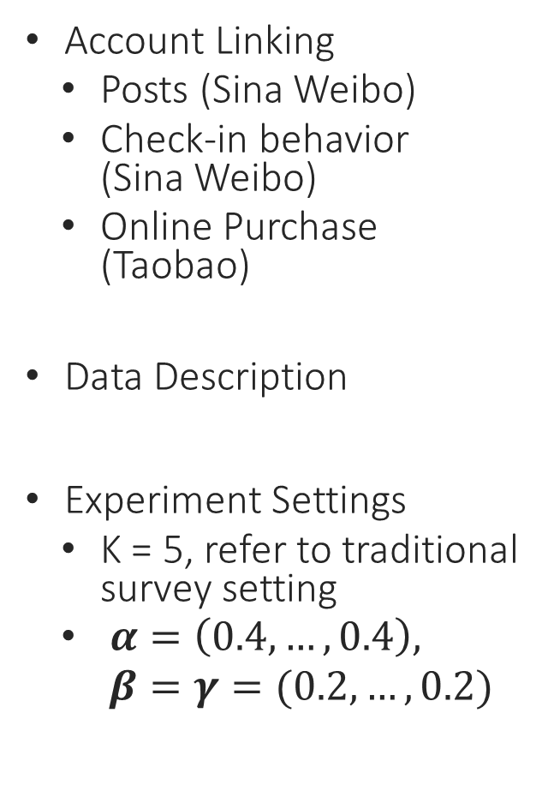
Experiment
Account Linking
Posts (Sina Weibo)
Check-in behavior (Sina Weibo)
Online Purchase (Taobao)
Data Description
Experiment Settings
K = 5, refer to traditional survey setting
$α=\left(0.4,…,0.4\right),$
$β=γ=(0.2,…,0.2)$
Notes:
And this link will lead to her Taobao page.

Slide 17
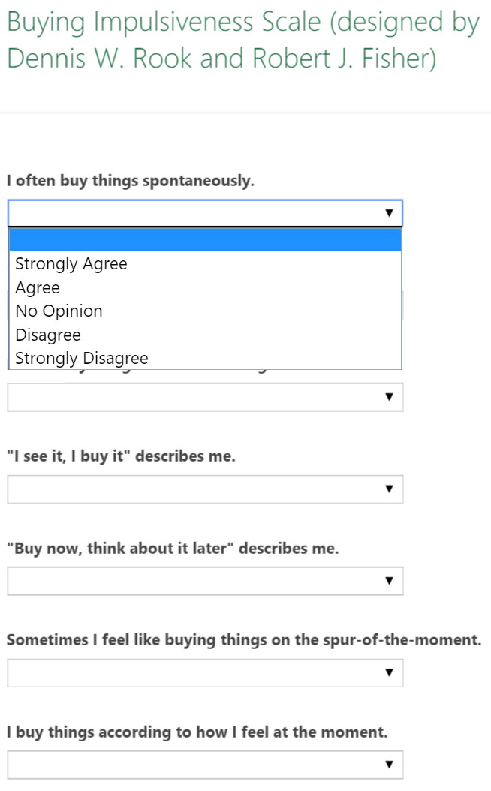
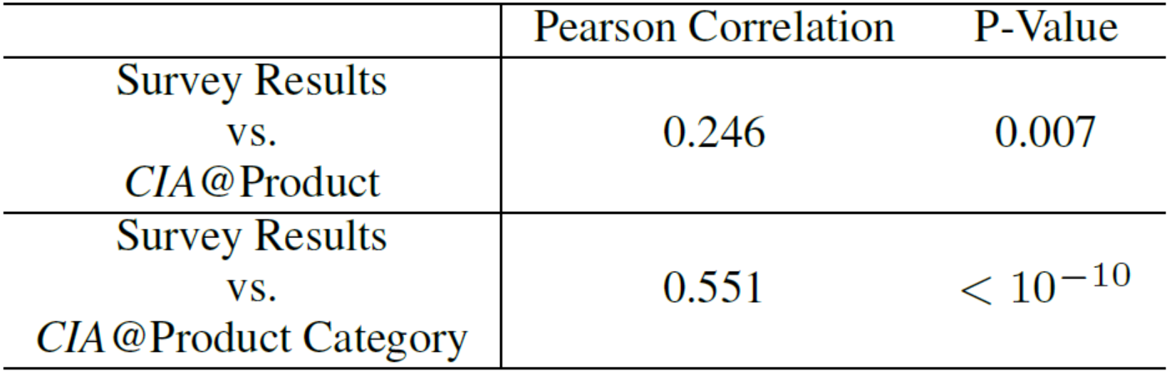
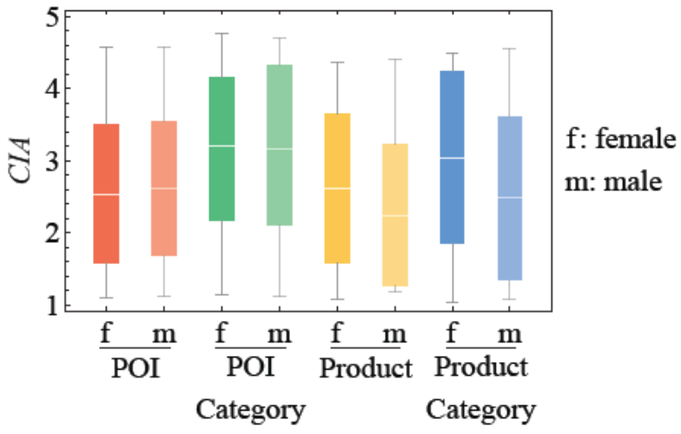
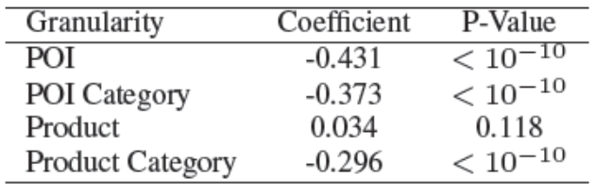
Effectiveness
CIA and Survey-based Result
Get survey results
Online shopping data, 976 users published email address. Then send invitations, 103 returned (56 males, 47 females)
Check-in data, only 21 users have email, ignored
CIA and demographics
Survey scale
Notes:
How evaluate the effectiveness of our inferred consumer impulsivity, we compare it with survey result. This validate that our mode is effective, and it is at some extent consistent to survey results.
For check-in, nearly no difference between male and female. The reason might be that most of consumption related check-in behavior are dining behavior, there is no explicit impulivie dining preference. For product and product category, we can see that female is acutally more impulsivie than male. Which is consistent that with our intuition, female is more emotional and is more easily to be persuade to buy something.

Slide 18
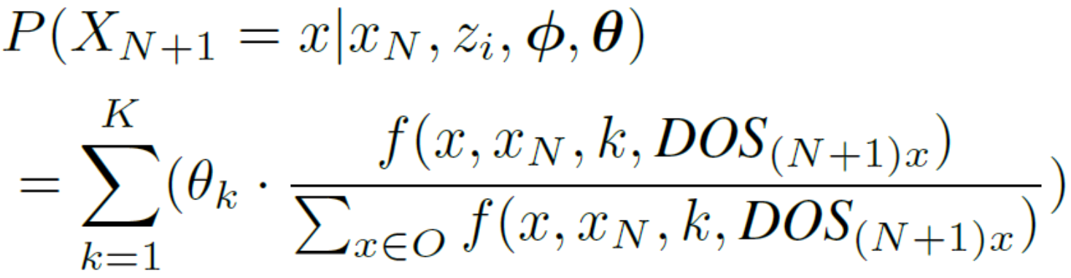
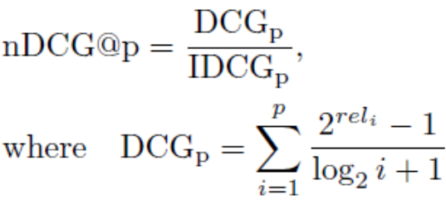
Prediction
Prediction in CIM model
Measurement
Baselines
OF | Order by visit frequency
MC | Order by transition probability
CRF | for each user, the chosen POI is treated as the hidden variable, and the POI-intensity vector is treated as the observation
FPMC | a factorization model embedding users’ latent preferences and their personalized Markov chains
COEDIT | user-POI matrix used as the auxiliary information source, applied transfer learning
Notes:
Our model can also be used for prediction, we will test the prediction performance when considering consumer impulsivity.

Slide 19
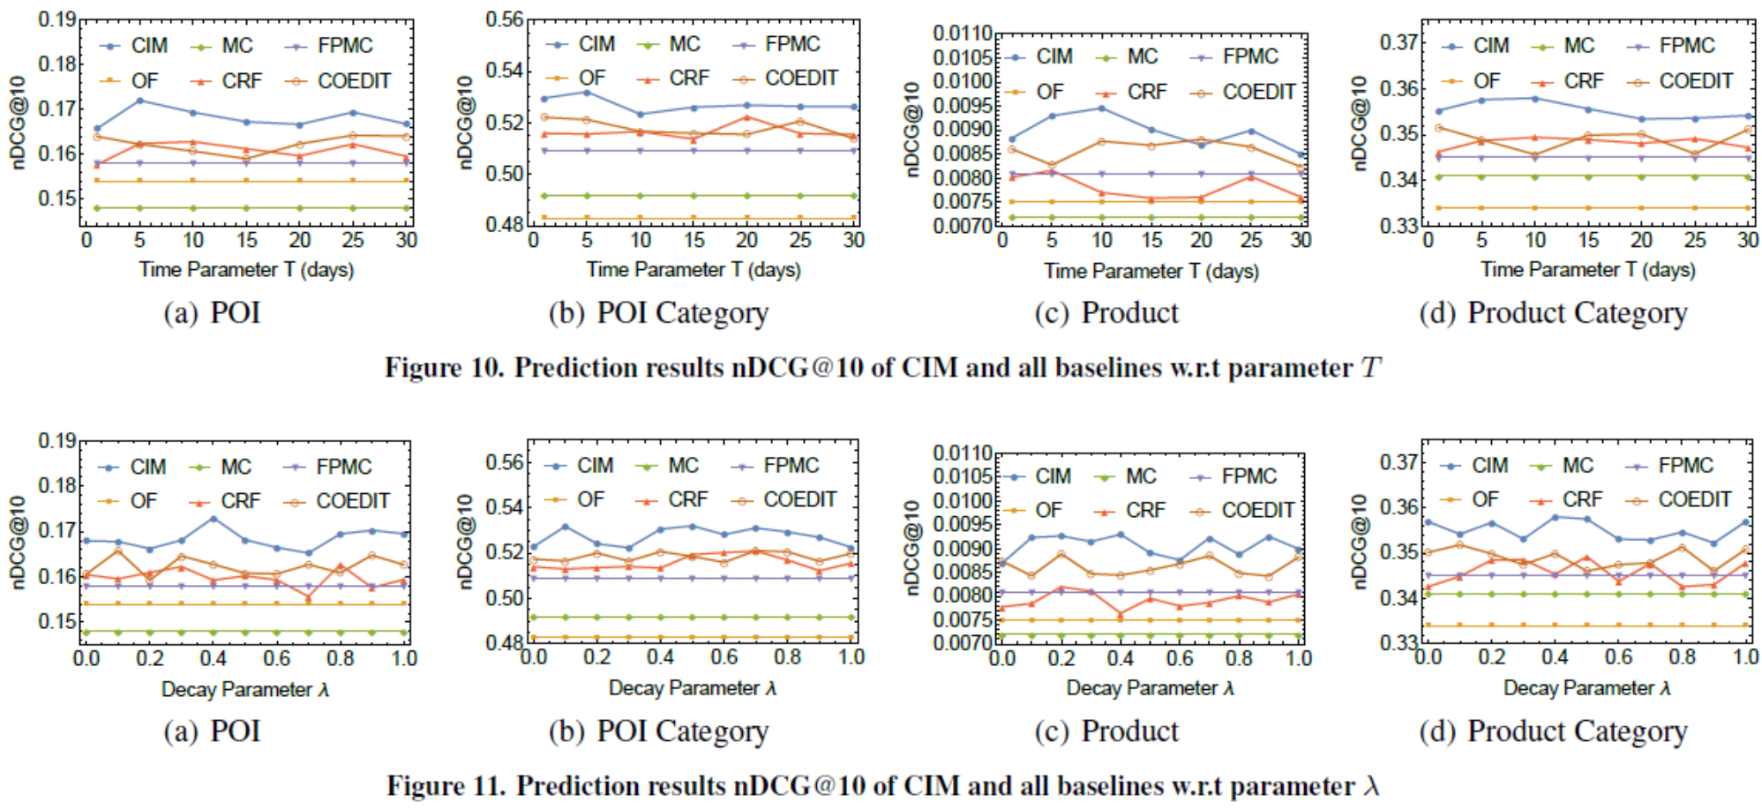
Performance with parameter $T$ and $λ$
Our model outperforms OF, MC and CRF, because frequency, transition frequency and stimuli intensity has been captured
Notes:
transfers the social network stimuli
knowledge as a whole while our method investigates into
the connection of behavior and social network stimuli at each
time point

Slide 20
Discussion
Generalization
Other stimuli can be incorporated into DOS computation, such as TV advertisements, offline promotions
Limitation
Other factors that influence consumption decision, e.g., spatial distance, mood, financial status
Stimuli intensity does not consider sentiment
Social influence is ignored, friends with different tie strength have different impact
Check-in in a store does not absolutely imply consuming anything
Privacy and ethical issues
The account linkage is self-disclosed, but users might not have enough attention
Ethical risks of using impulsivity to interface consumer’s decision

Slide 21
Summary
Developed a Bayesian approach to model consumer impulsivity by leveraging consumer behavior and perceived stimuli on social networks
Offer in-depth analytics in exploring consumer impulsivity in both offline and online consumption domains.
Conduct extensive experiments to evaluate the effectiveness of CIA and its prediction performance.
Fuzheng Zhang

Slide 22
Thanks!

